Slide 1

CET-----: Object Oriented Programming using C++
SCHOOL OF COMPUTER ENGINEERING AND TECHNOLOGY
F. Y. B. TECH. COMPUTER SCIENCE AND ENGINEERING (CYBERSECURITY AND FORENSICS)

Slide 2

Practical Assignments
Assignment No. | Assignment Title | Workload in Hrs.
 |  | Lab.
1. | Implement basic concept of object, classes, static members and friend functions in C++ | 06
2. | Implement constructors and destructors in C++. | 04
3. | Implement the concept of inheritance in C++. | 04
4. | Implement the concept of polymorphism and pure virtual function in C++. | 02
5. | Implement concept of exception handling in C++ | 02
6. | Implement file handling and File input output operations in C++ | 02
7. | Implement template in C++ | 02
8. | Implement concept of STL in C++ . | 02
9. | Mini Project | 06

Slide 3
Assignment No. 8 Demonstrating the implementation of STL in C++

Slide 4
Laboratory Assignment No: 8
Problem Statement
A shop maintains the inventory of items. It stores information of items like
Item_Code
Item_Name
Item_Quantity
Item_Cost per unit in a list of STL.
Whenever Customer wants to buy an item, sales person inputs the Item_Code and /or Item_Name. Then the system searches in a list items and displays whether it is available or not otherwise an appropriate message is displayed as “Requested Item is not Available”.
If item is available, then the system displays the item details and request for the quantity of items required to purchase.
If the requested quantity of items is available, the total billing information with cost of item is displayed; otherwise the message is displayed as “Required item’s Quantity is not in stock”. After purchasing an item, system updates the list.
Design a system using a class called Items with suitable data members and member functions. Implement menu driven C++ program for the inventory system using STL list.

Slide 5
Getting started with Standard Template Library (STL)

Slide 6
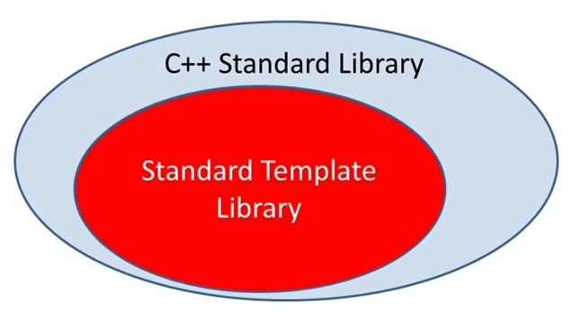
STL-Standard Template Library
The Standard Template Library (STL) is a set of C++ template classes to provide common programming data structures and functions such as lists, stacks, arrays, etc.
It is a library of container classes, algorithms and iterators.
It is a generalized library and so, its components are parameterized.
Collection of useful classes for common data structure
Ability to store objects of any type (template)
STL has four components
Algorithms
Containers
Functions
Iterators

Slide 7
Standard Template Library
The STL-Standard Template Library contains:
Containers
Algorithms
Iterators
A container is a way that stored data is organized in memory , for example an array of elements.
Algorithms in the STL are producers that are applied to containers to process their data for example search for an element in an array or sort an array
Iterators are a generalization of the concept of pointers they point to elements in a container for example you can increment an iterator to point to the next element in an array

Slide 8
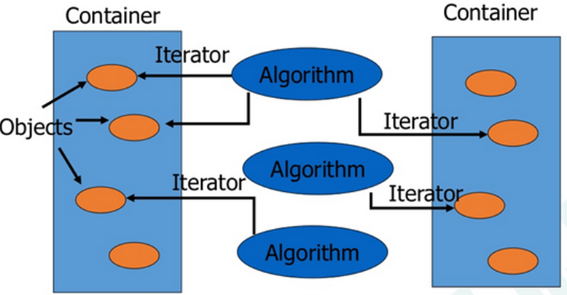
Standard Template Library

Slide 9
Container
A container is a way to store data, either built-in data types like int and float or class objects
Containers or container classes store objects and data.
There are in total seven standard “first-class” container classes and three container adaptor classes and only seven header files that provide access to these containers or container adaptors.

Slide 10
Container
Sequence Containers: implement data structures which can be accessed in a sequential manner.
Vector
List
Deque
Arrays
Forward List
Container Adaptors : provide a different interface for sequential containers.
Queue
Priority Queue
Stack
Associative Containers : implement sorted data structures that can be quickly searched (O(log n) complexity).
Set
Multiset
Map
Multimap

Slide 11
Sequence Containers: Array and Linked List
A sequence container stores a set of elements in sequence in other words each element is preceded by one specific element and followed by another <vector>, <list> and <deque> are sequential containers.
<vector> : is an expandable array that can shrink or grow in size but still has the disadvantage of inserting or deleting elements in the middle.
<list> : is a traditional double linked list it is quick to insert or delete elements but has v.slow random access
<deque> : is a double-ended queue that means one can insert and delete elements from both ends it is a kind of combination between a stack and a queue

Slide 12

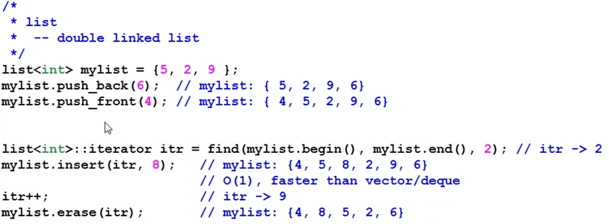
Linked List

Slide 13
Algorithms
The Standard Template Library provides a number of useful, generic algorithms to perform the most commonly used operations on groups/sequences of elements. These operations include traversals, searching, sorting and insertion/removal of elements.
The way that these algorithms are implemented is closely related to the idea of the containers and iterators, although, as we will see, they can be used with standard arrays and pointers.

Slide 14
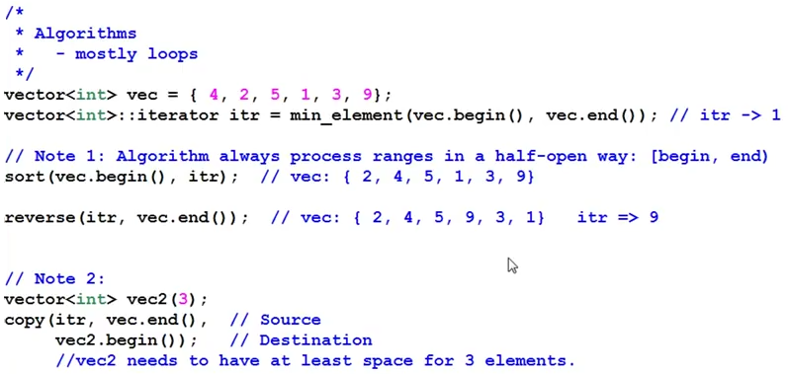
Algorithms

Slide 15
Iterators
Iterators are allow to traverse sequences
Main Methods
operator*
operator++, and operator—
Different types of iterators - to support read, write and random access
Containers define their own iterator types
Changing the container can invalidate the iterator

Slide 16
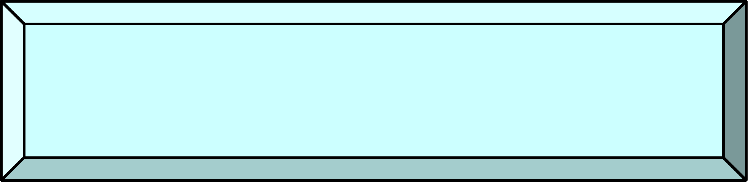
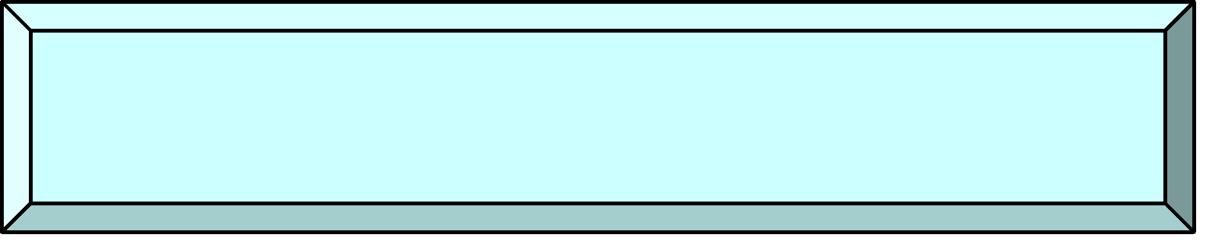
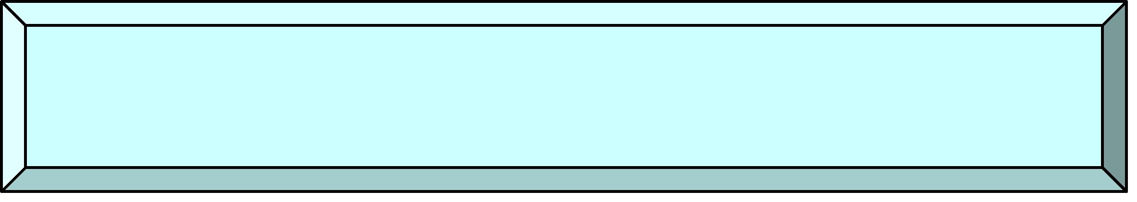
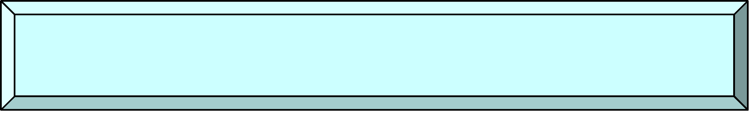
Iterators
input
++, input
Trivial Iterator
++, output
Input Iterator
Output Iterator
++, I/O
Forward Iterator
++, --, I/O
Bi-directional Iterator
Pointer
arithmetic
Random-Access Iterator

Slide 17
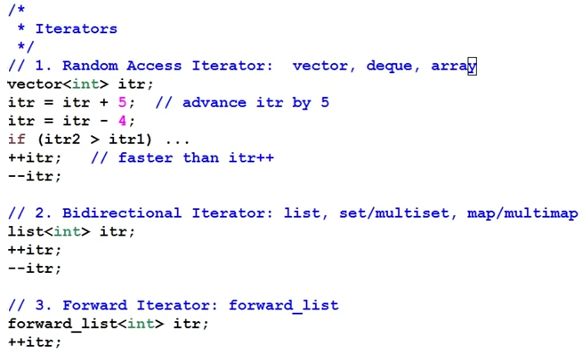
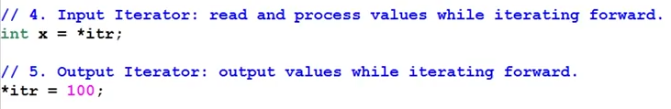
Iterators

Slide 18
Problem Statement Implementation Details
Data Members
Item_Code
Item_Name
Item_Quantity
Item_Price
Member Function to perform the operations as
Create STL list and store Record of Items
Search an Item in the file by Item_Code or Item_Name(Searching)
Display Item Information
Purchase an Item and Display Billing Information
Update the file(Insert and delete)
Arrange the Items by Item_Code or Item_Name(Sorting)

Slide 19
Algorithm
START
Create Item class and its object
Store the items information into the list using object of item class
Insert the item information (Item_Code, Item_Name, Quantity and price) in a list using push_front() and / or push_back() function..
Input Item_Code or Item_Name from user to search Item record.
If Match found then display the complete record of Item (Item_Code, Item_Name, Quantity and Cost).
Else Display Message that Record not found.
Input no of quantity to purchase and display billing information else display message “Stock insufficient”
Update records after successful purchase operation
Display the sorted list of items.
Delete the item information (Item_Code, Item_Name, Quantity and Cost) in a list using pop_front() and pop_back() function if zero item quantities present in staock.
STOP

Slide 20
LIST Container in STL
Syntax for creating a new linked list using list template is
Similar to vector and array, lists can also be initialized with parameters,
#include <iostream>
#include <list>
using namespace std;
int main()
{
std::list<int> l{1,2,3};
}
/* Creates a new linked list l */
#include <iostream>
#include <list>
int main()
{
std::list<int> l;
}
/* Creates a new empty linked list l */

Slide 21
Member Functions of List Container
insert function
This method, as the name suggests, inserts an element at specific position, in a list. There are 3 variations of insert(), they are as follows :
insert(iterator, element) : inserts element in the list before the position pointed by the iterator.
insert(iterator, count, element) : inserts element in the list before the position pointed by the iterator, count number of times.
insert(iterator, start_iterator, end_iterator): insert the element pointed by start_iterator to the element pointed by end_iterator before the position pointed by iterator

Slide 22
#include <iostream>
#include <list>
using namespace std;
int main()
{
list<int> l = {1,2,3,4,5};
list<int>::iterator it = l.begin();
l.insert (it+1, 100); // insert 100 before 2 position
/* now the list is 1 100 2 3 4 5 */
list<int> new_l = {10,20,30,40}; // new list
new_l.insert (new_l.begin(), l.begin(), l.end());
/* insert elements from beginning of list l to end of list l before 1 position in list new_l */
/* now the list new_l is 1 100 2 3 4 5 10 20 30 40 */
l.insert(l.begin(), 5, 10); // insert 10 before beginning 5 times
/* now l is 10 10 10 10 10 1 100 2 3 4 5 */
return 0;
}

Slide 23
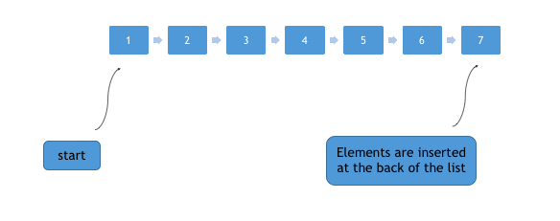
push_back and push_front functions
push_back(element) method is used to push elements into a list from the back.

Slide 24
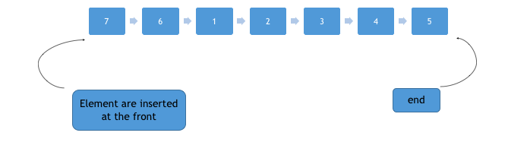
push_back and push_front functions
push_front(element) method is used to push elements into a list from the front.

Slide 25
push_back and push_front functions_Example
#include <iostream>
#include <list>
using namespace std;
int main()
{
list<int> l{1,2,3,4,5};
l.push_back(6);
l.push_back(7);
/* now the list becomes 1,2,3,4,5,6,7 */
l.push_front(8);
l.push_front(9);
/* now the list becomes 9,8,1,2,3,4,5,6,7 */
}

Slide 26
pop_back and pop_front functions
pop_front() removes first element from the start of the list.
While pop_back() removes first element from the end of the list.
#include <iostream>
#include <list>
using namespace std;
int main()
{
list<int> l{1,2,3,4,5};
l.pop_back();
/* now the list becomes 1,2,3,4 */
l.pop_front();
/* now the list becomes 2,3,4 */
}

Slide 27
List functions
empty function
This method returns true if the list is empty else returns false.
size function
This method can be used to find the number of elements present in the list.
front and back function
front() is used to get the first element of the list from the start while back() is used to get the first element of the list from the back.
swap function
Swaps two list, if there is exception thrown while swapping any element, swap() throws exception. Both lists which are to be swapped must be of the same type, i.e you can’t swap list of an integer with list of strings.
reverse function
This method can be used to reverse a list completely.

Slide 28
Practice Assignments
Program to insert, delete and sort list contents according to Item_Code, Item_Name, Quantity and Cost in STL
Write C++ program using STL for implementation of stack and queue operation using List Container

Slide 29
Take-away
Creation of object from class is necessary
Passing class name while writing template syntax for list is necessary
Pass object of class to the inbuild functions

Slide 30
Frequently Asked Questions
What are class templates? How are they created? What is the need for class templates? Create a template for bubble sort functions.
Explain with example, how Function Templates are implemented?
Explain with example how can a class template be created.
What is Standard Template Library? How is it different from the C++ Standard Library?
Explain Generic functions and Generic class.

Slide 31
Program Source Code
Implemented program source code for reference

Slide 32
Learning Resources
Text books Robert Lafore, ‘Object-Oriented Programming in C++’, Fourth Edition, Sams Publishing, ISBN: 0672323087, ISBN-13: 978-8131722824 Deitel, “C++ How to Program”, 10th Edition, Pearson Education, ISBN 13: 9780134448237 Reference Books Herbert Schildt, ‘C++ The Complete Reference’, Eighth Edition, McGraw Hill Professional, 2011, ISBN-13: 978-0072226805 Bjarne Stroustrup, ‘The C++ Programming language’, Seventh Edition, Pearson Education. ISBN: 9788131705216 K. R. Venugopal, Rajkumar Buyya, T. Ravishankar, ‘Mastering C++’, Tata McGraw-Hill, ISBN 13: 9780074634547 E. Balaguruswamy, “Object-Oriented Programming with C++”, 7th edition, Graw-Hill Publication, ISBN 10:9352607996 ISBN 13:9789352607990

Slide 33
Learning Resources
Web Resources: https://www.springer.com/gp/book/9781852334505 https://www.ebookphp.com/object-oriented-programming-in-c-epub-pdf/ https://www.springer.com/gp/book/9781447133780 MOOCs: https://www.coursera.org/learn/c-plus-plus-a https://nptel.ac.in/courses/106/105/106105151/

Slide 34
Thank You!

